Slide 1
User Web Interactions Prediction: SPRINT 2
Gabriel Falcones Paredes
Spring 2021

Slide 2
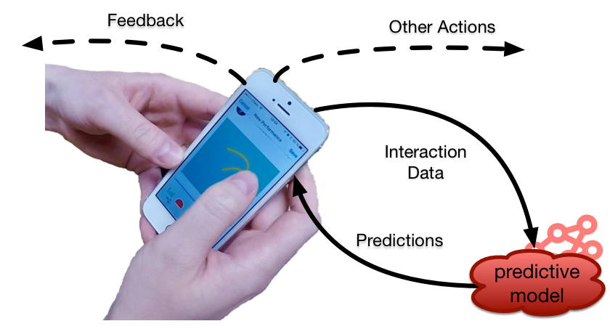
Project Description
Implementation of machine learning system to predict user interactions on a web application.
Uses:
Improve browser experience
Pre-send, pre-fetch data
recommendations
web caching
recover from errors

Slide 3
Sprint 2
Knowledge forum dataset.
  Collection of server logs of different user interactions.
  Data mining: select important features and interactions.
  Classify each interaction (22 different actions).
  Split into different sequences
    Read note
    Create note
    Edit note
    Insert attachments
    Insert/Delete Scaffolds
  ~800 interactions, split into 80 sequences

Slide 4
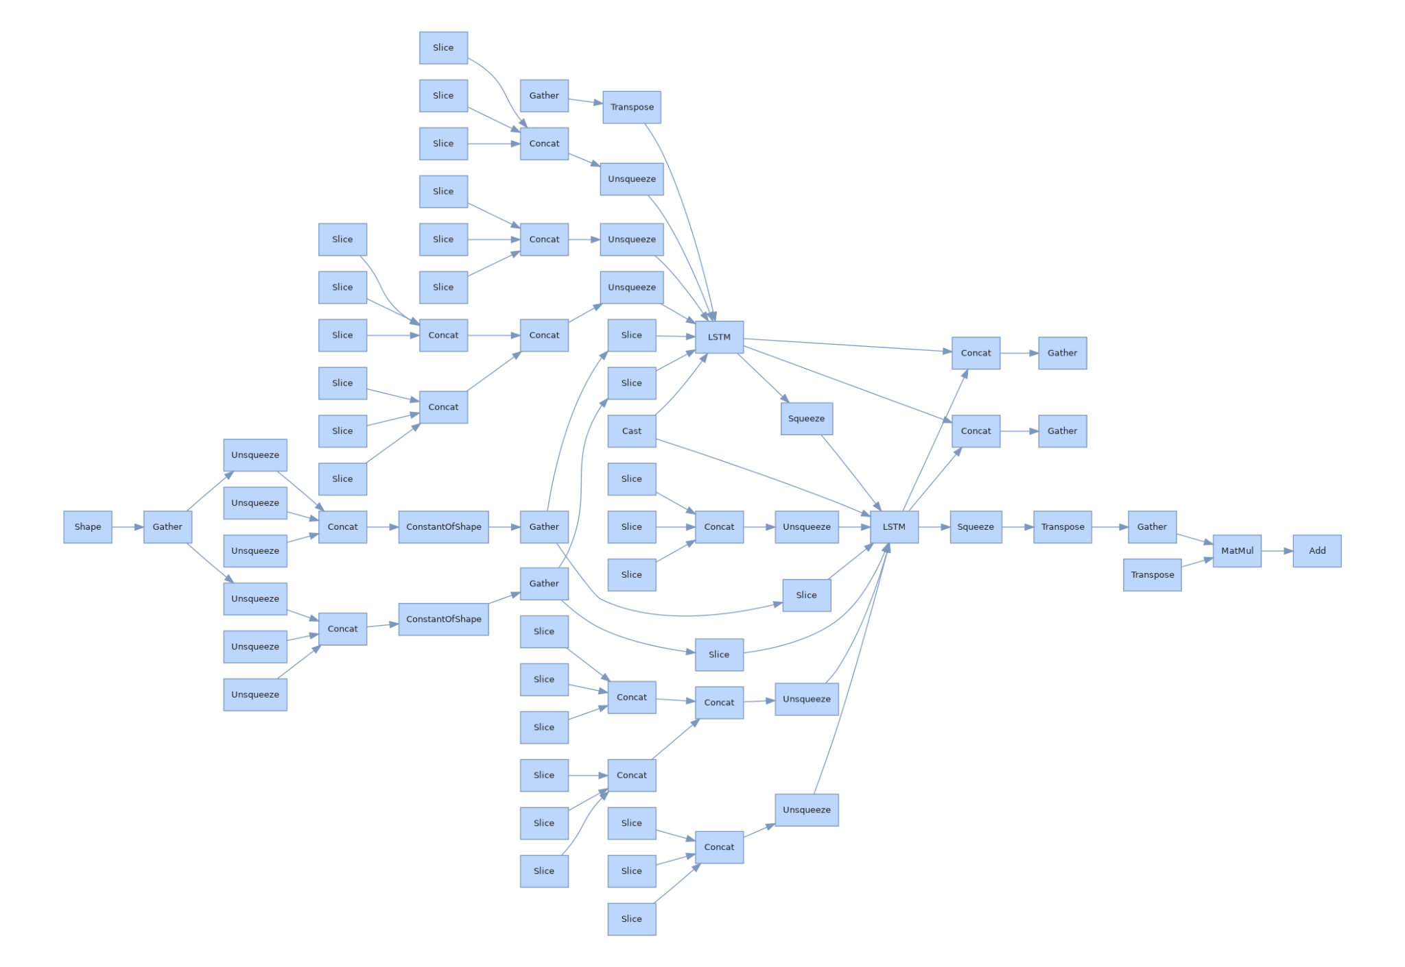
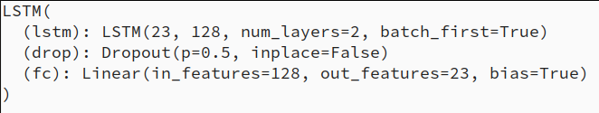
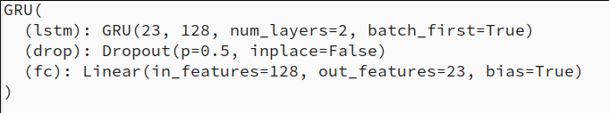
Sprint 2
Train/Validate model(s).
  LSTM
    AVG Loss: 0.5880
  GRU
    AVG Loss: 0.6041

Slide 5
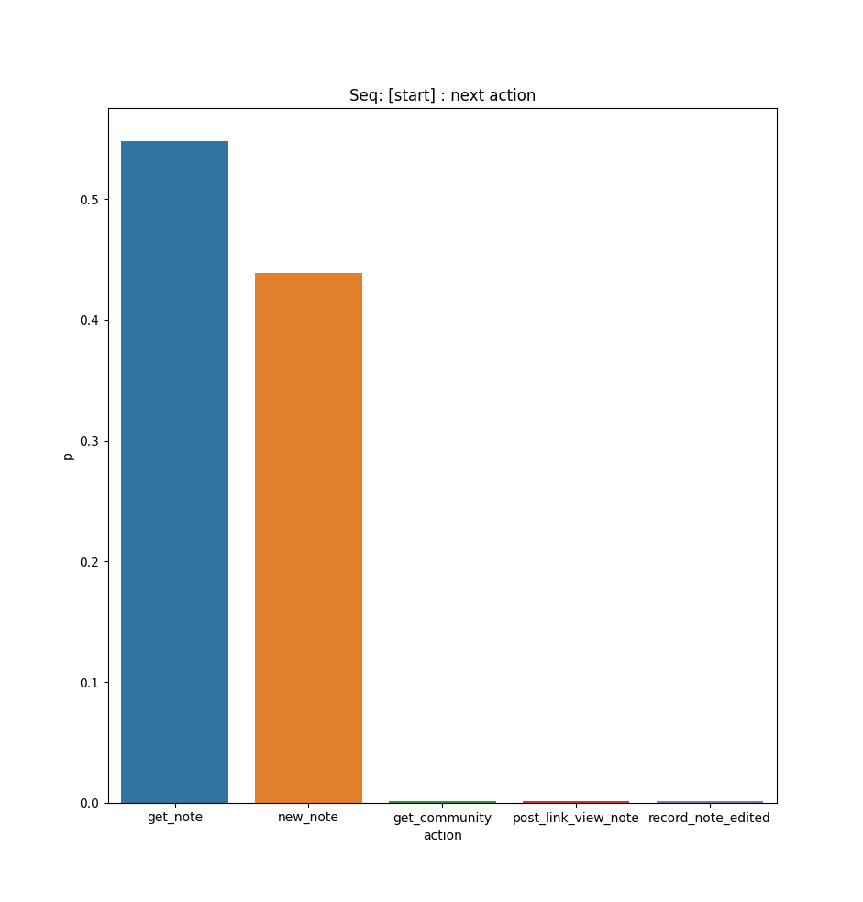
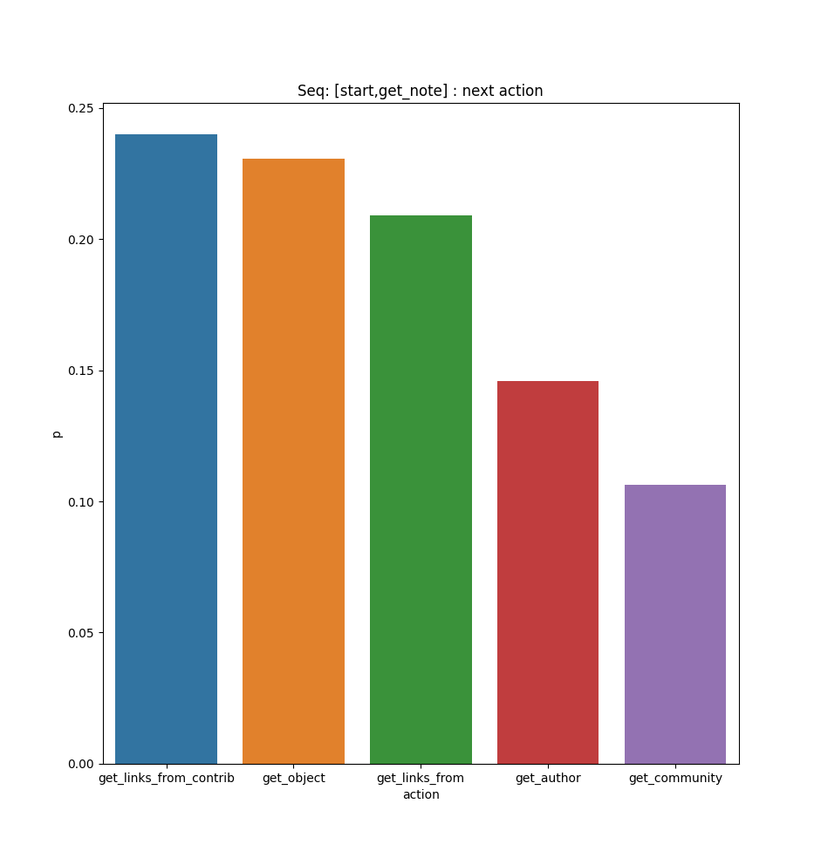
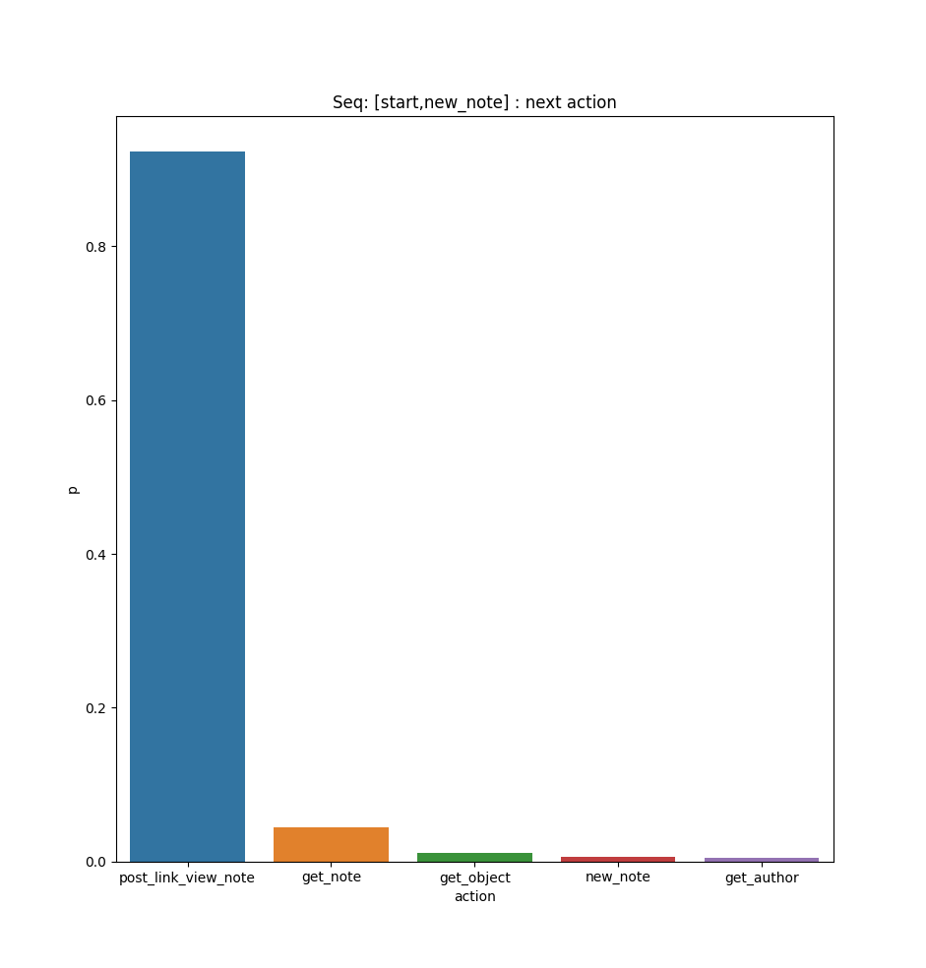
Sprint 2
Prediction Results: Top 5 most probable next predictions

Slide 6
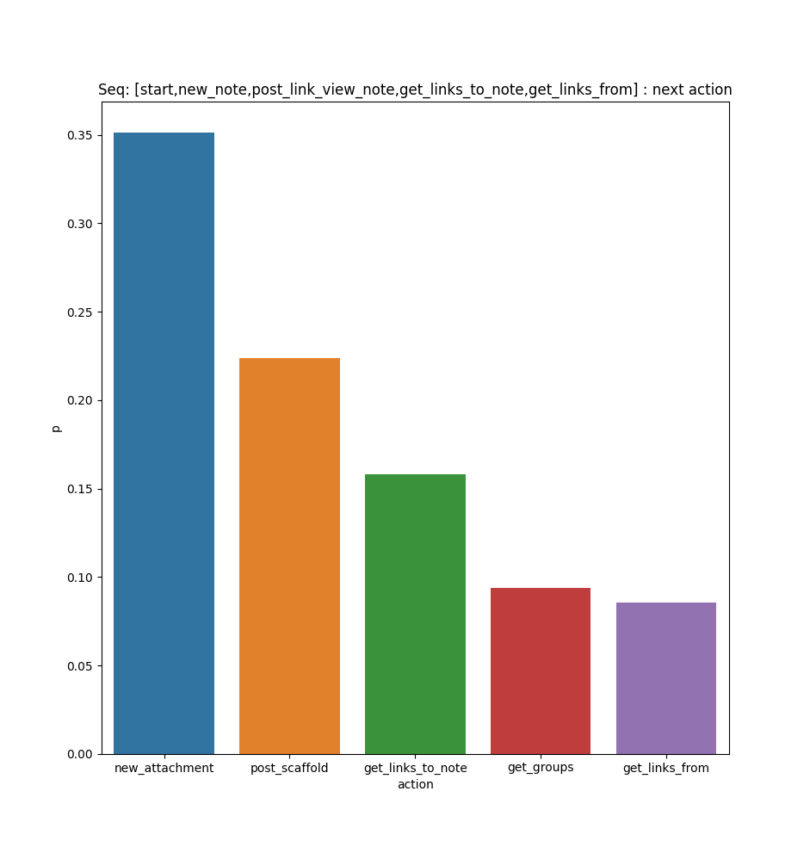
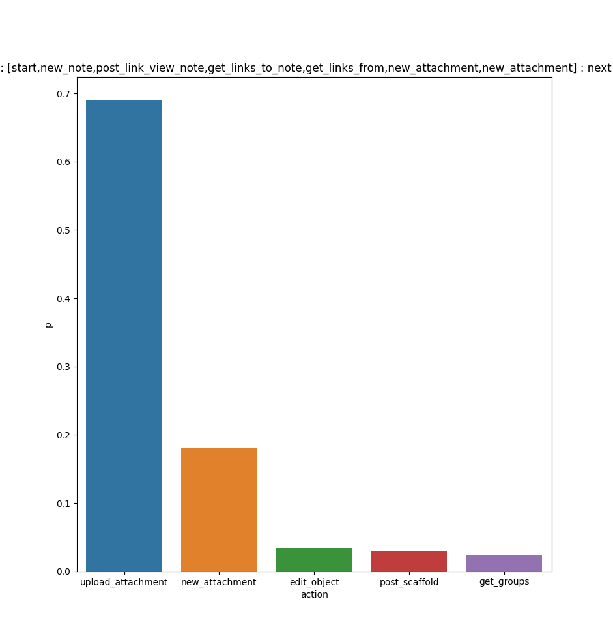
Sprint 2
Prediction Results: Top 5 most probable next predictions

Slide 7
Sprint 3
Expand dataset with more features/interaction types and retrain model
Create web server to handle requests and return predictions
  Receive user interactions in real time
  Return possible future actions
  Display stats
Integrate with knowledge forum server/client.

